Slide 1
Comp 225
Introduction to Operating Systems
Threads & Concurrency
Dr. Gikaru
Computer Science
Egerton University

Slide 2
Threads
Processes have the following components:
  an address space
  a collection of operating system state
  a CPU context … or thread of control
On multiprocessor systems, with several CPUs, it would make sense for a process to have several CPU contexts (threads of control)
  Thread fork creates new thread not memory space
  Multiple threads of control could run in the same memory space on a single CPU system too!
Notes:
Context switching between thread is cheaper… ASK WHY?
Because you don’t have O.S. to change.

Slide 3
Threads
Threads share a process address space with zero or more other threads
Threads have their own
  PC, SP, register state, stack
A traditional process can be viewed as a memory address space with a single thread
Notes:
Context switching between thread is cheaper… ASK WHY?
Because you don’t have O.S. to change.

Slide 4
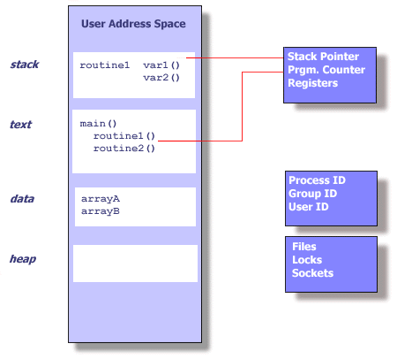
Single thread state within a process

Slide 5
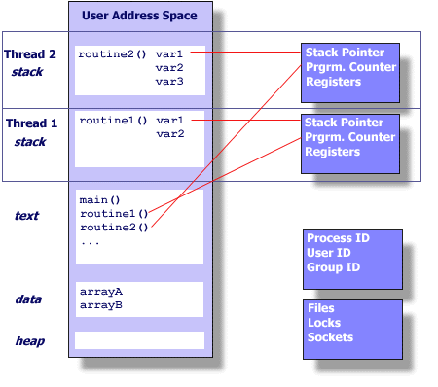
Multiple threads in an address space

Slide 6
What is a thread?
A thread executes a stream of instructions
  it is an abstraction for control-flow
Practically, it is a processor context and stack
  Allocated a CPU by a scheduler
  Executes in the context of a memory address space

Slide 7
Summary of private per-thread state
Things that define the state of a particular flow of control in an executing program:
  Stack (local variables)
  Stack pointer
  Registers
  Scheduling properties (i.e., priority)

Slide 8
Shared state among threads
Things that relate to an instance of an executing program (that may have multiple threads)
  User ID, group ID, process ID
  Address space
    Text
    Data (off-stack global variables)
    Heap (dynamic data)
  Open files, sockets, locks
Important: Changes made to shared state by one thread will be visible to the others
  Reading and writing memory locations requires synchronization! … a major topic for later …

Slide 9
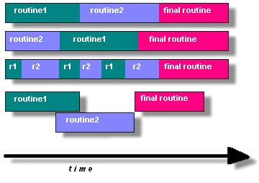
How do you program using threads?
Split program into routines to execute in parallel
  True or pseudo (interleaved) parallelism
Alternative
strategies for
executing multiple
rountines

Slide 10
Why program using threads?
Utilize multiple CPU’s concurrently
Low cost communication via shared memory
Overlap computation and blocking on a single CPU
  Blocking due to I/O
  Computation and communication
Handle asynchronous events

Slide 11

Thread usage
A word processor with three threads

Slide 12
Processes versus threads - example
A WWW process
HTTPD
GET / HTTP/1.0
disk

Slide 13
Processes versus threads - example
A WWW process
HTTPD
GET / HTTP/1.0
disk
Why is this not a good web server design?

Slide 14
Processes versus threads - example
A WWW process
HTTPD
HTTPD
GET / HTTP/1.0
disk

Slide 15
Processes versus threads - example
A WWW process
HTTPD
GET / HTTP/1.0
GET / HTTP/1.0
disk

Slide 16
Processes versus threads - example
A WWW process
HTTPD
GET / HTTP/1.0
GET / HTTP/1.0
GET / HTTP/1.0
disk
GET / HTTP/1.0

Slide 17

Threads in a web server
A multithreaded web server

Slide 18
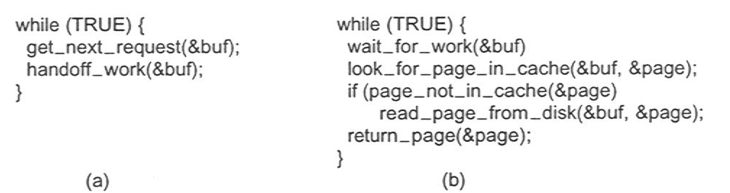
Thread usage
Rough outline of code for previous slide
  (a) Dispatcher thread
  (b) Worker thread

Slide 19
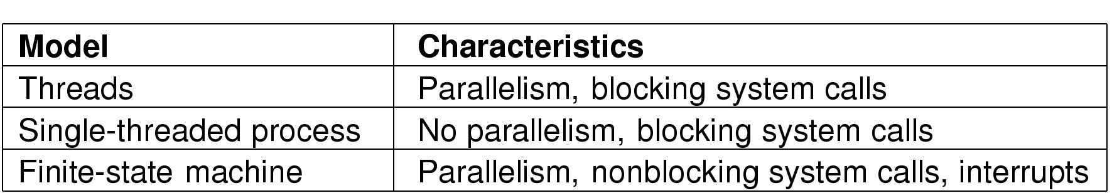
System structuring options
Three ways to construct a server

Slide 20
Common thread programming models
Manager/worker
  Manager thread handles I/O and assigns work to worker threads
  Worker threads may be created dynamically, or allocated from a thread-pool
Pipeline
  Each thread handles a different stage of an assembly line
  Threads hand work off to each other in a producer-consumer relationship

Slide 21
What does a typical thread API look like?
POSIX standard threads (Pthreads)
First thread exists in main(), typically creates the others
pthread_create (thread,attr,start_routine,arg)
  Returns new thread ID in “thread”
  Executes routine specified by “start_routine” with argument specified by “arg”
  Exits on return from routine or when told explicitly

Slide 22
Thread API (continued)
pthread_exit (status)
  Terminates the thread and returns “status” to any joining thread
pthread_join (threadid,status)
  Blocks the calling thread until thread specified by “threadid” terminates
  Return status from pthread_exit is passed in “status”
  One way of synchronizing between threads
pthread_yield ()
  Thread gives up the CPU and enters the run queue

Slide 23
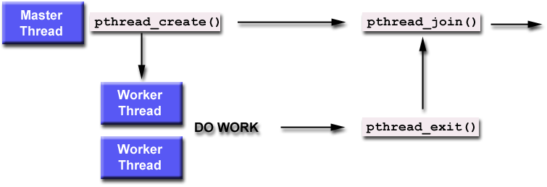
Using create, join and exit primitives

Slide 24
An example Pthreads program
#include <pthread.h>
#include <stdio.h>
#define NUM_THREADS 5
void *PrintHello(void *threadid)
{
printf("\n%d: Hello World!\n", threadid);
pthread_exit(NULL);
}
int main (int argc, char *argv[])
{
pthread_t threads[NUM_THREADS];
int rc, t;
for(t=0; t<NUM_THREADS; t++)
{
printf("Creating thread %d\n", t);
rc = pthread_create(&threads[t], NULL, PrintHello, (void *)t);
if (rc)
{
printf("ERROR; return code from pthread_create() is %d\n", rc);
exit(-1);
}
}
pthread_exit(NULL);
}
Program Output
Creating thread 0
Creating thread 1
0: Hello World!
1: Hello World!
Creating thread 2
Creating thread 3
2: Hello World!
3: Hello World!
Creating thread 4
4: Hello World!
For more examples see: http://www.llnl.gov/computing/tutorials/pthreads

Slide 25
Pros & cons of threads
Pros
  Overlap I/O with computation!
  Cheaper context switches
  Better mapping to shared memory multiprocessors
Cons
  Potential thread interactions
  Complexity of debugging
  Complexity of multi-threaded programming
  Backwards compatibility with existing code
Notes:
Context switching between thread is cheaper… ASK WHY?
Because you don’t have O.S. to change.

Slide 26
User-level threads
The idea of managing multiple abstract program counters above a single real one can be implemented using privileged or non-privileged code.
  Threads can be implemented in the OS or at user level
User level thread implementations
  thread scheduler runs as user code (thread library)
  manages thread contexts in user space
  The underlying OS sees only a traditional process above

Slide 27
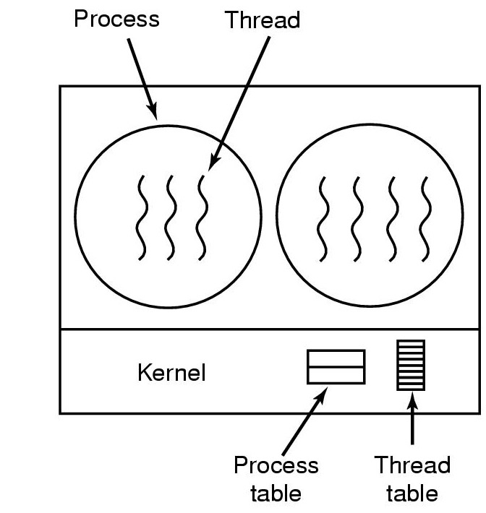
Kernel-level threads
The thread-switching code is in the kernel

Slide 28
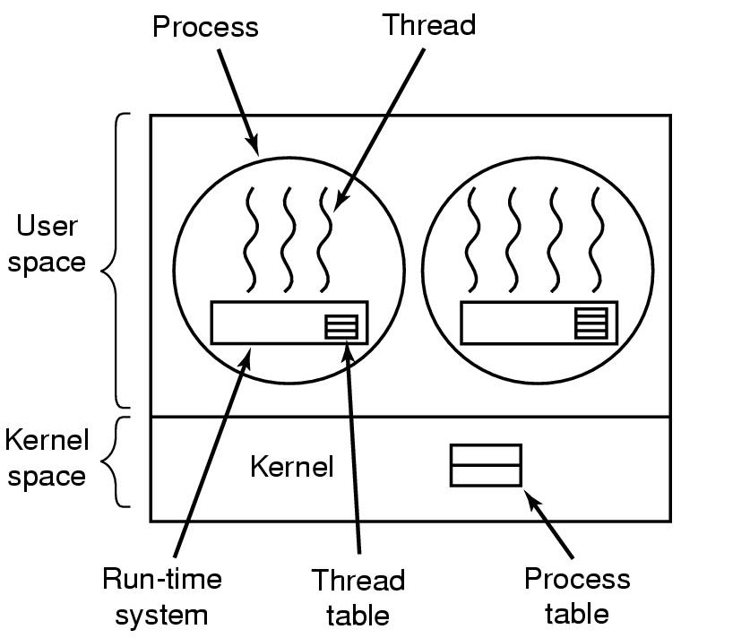
User-level threads package
The thread-switching code is in user space

Slide 29
User-level threads
Advantages
  cheap context switch costs among threads in the same process!
    A procedure call not a system call!
  User-programmable scheduling policy
Disadvantages
  How to deal with blocking system calls!
  How to overlap I/O and computation!

Slide 30
END

